Slide 1

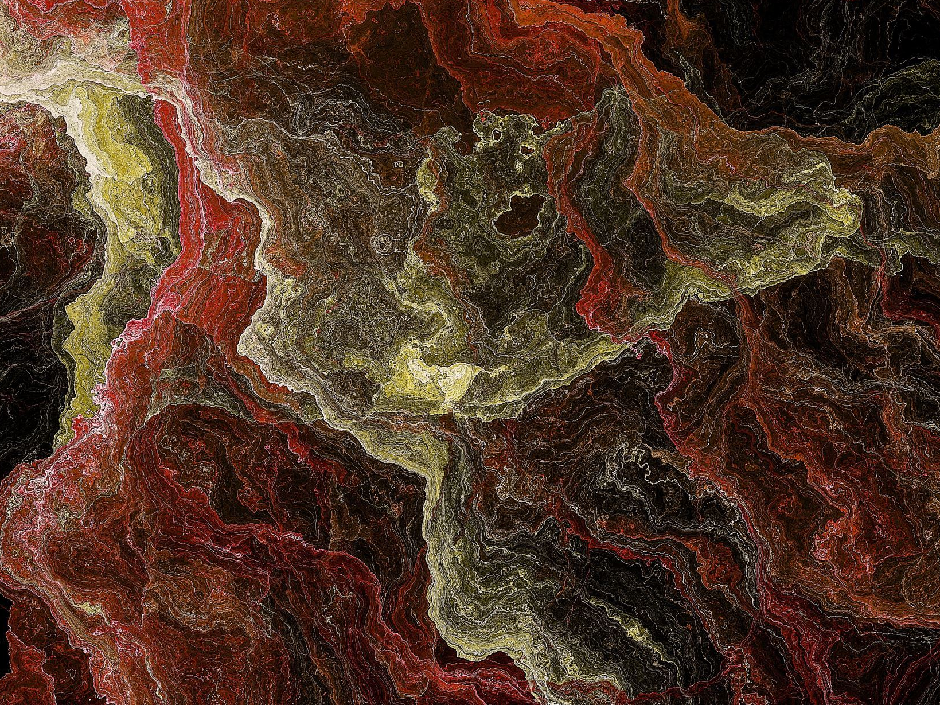
Displays & Image Processing
Chapter 15

Slide 2
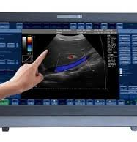
Displays
Display refers to the screen on which your images are shown.
In diagnostic ultrasound this is most often a cathode ray tube, or a flat panel monitor.

Slide 3
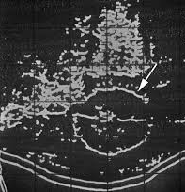
Bistable vs. Gray Scale
There are two choices that we can have in image display.
Bistable
White or black, on or off
high contrast, narrow dynamic range, poor contrast resolution

Slide 4
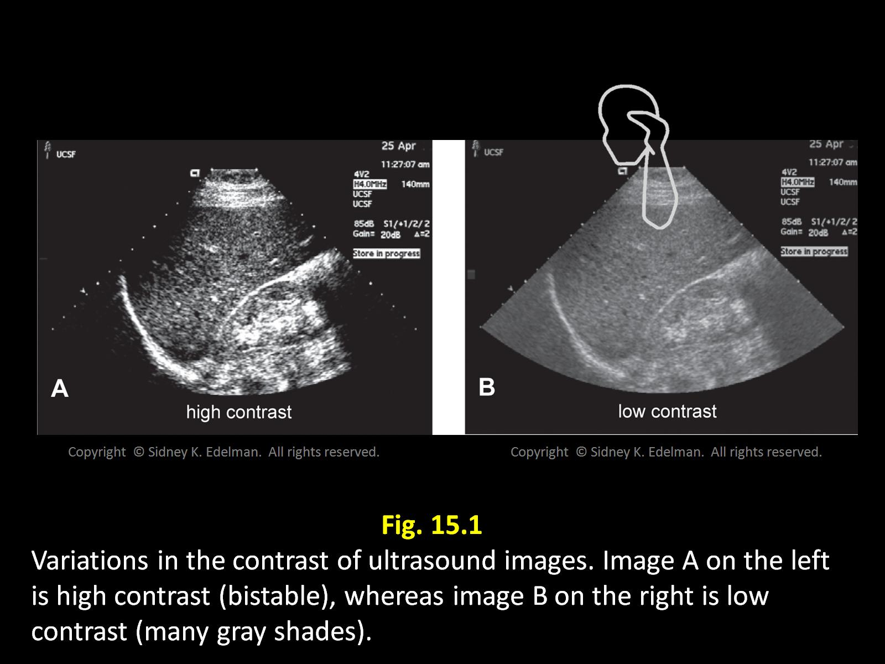

Slide 5
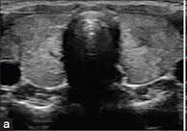
Bistable vs. Gray Scale
Gray Scale
many levels of brightness. (white light gray, medium gray, dark gray etc)
Assignment of a different shade of gray for each echo amplitude
Different colors represent different signal strengths
Low contrast, wide dynamic range, improved contrast resolution

Slide 6
Controls of a display (Just like the controls on your TV)
Contrast
Determines range of brilliancies that are displayed.
Bistable images are high contrast.
Brightness
Determines the brilliance of the signals displayed

Slide 7
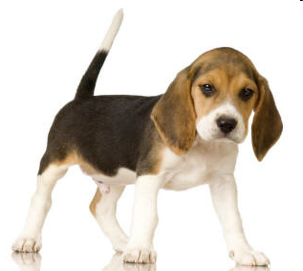
Contrast Resolution
Shades of gray in an image
Good contrast beagle!
Poor contrast beagle!

Slide 8
Brightness
Bright!
Dark!

Slide 9
Scan Converters
Changes the data format from US signals to that of a television
Scan converters make gray scale displays possible by storing the image information and then displaying it on a Cathode Ray tube
Storage is called "writing"
Later, image data is "read" for display on the monitor
This also allows the image to be manipulated/altered between storing and displaying.
Ex. Black and white inversion

Slide 10
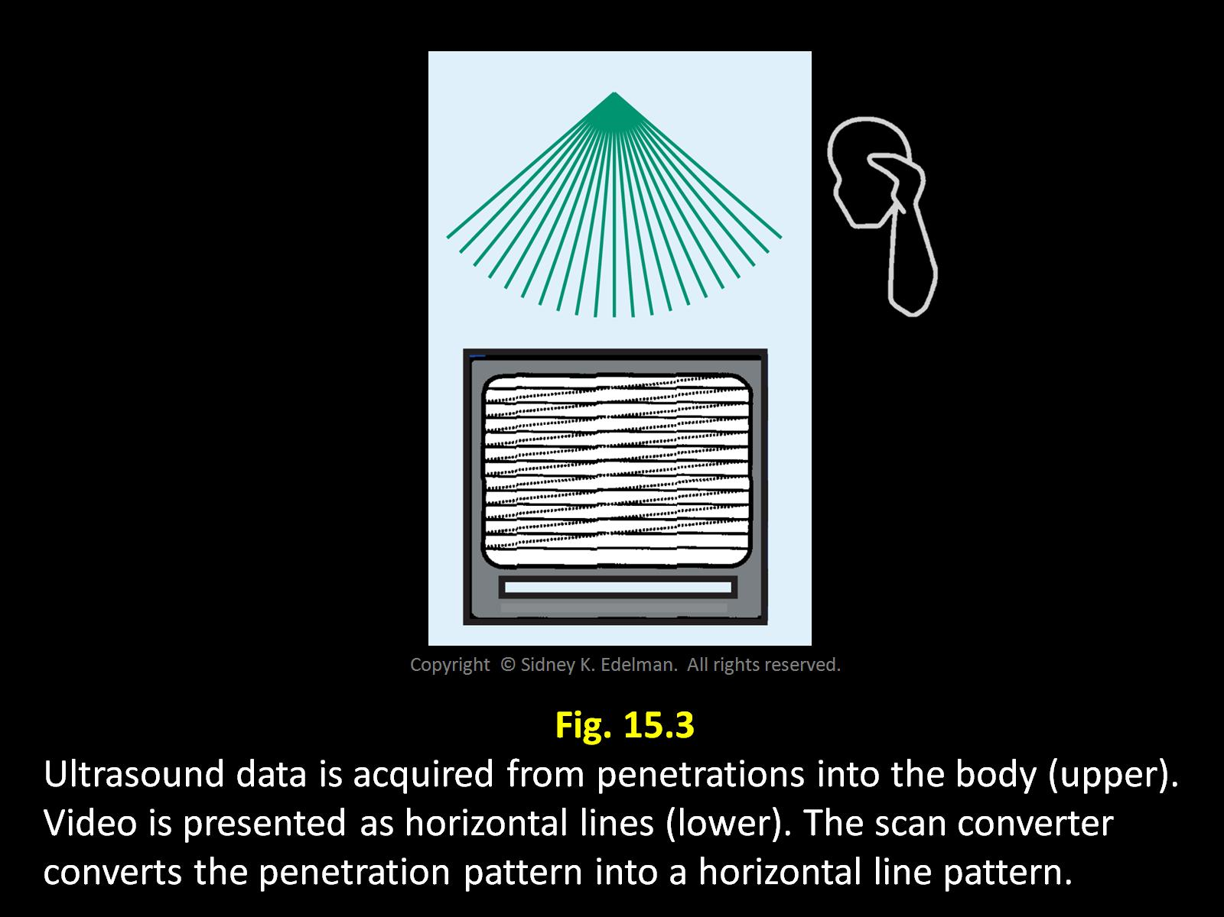

Slide 11

Analog and Digital
Oh dear…
Analog
real world
a variable attains a continuum of values
Actual weight of a beagle
True length of a beagle
Digital
computer world
a variable attains only discrete values.
Measuring the Beagle’s weight on a digital scale

Slide 12
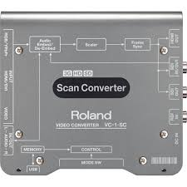
Analog Scan Converter
Originally made gray scale display possible
Funnel shaped tube with an electron gun
Divides pictures into a dielectric matrix with an electrical storage element (silicon wafer)
Electrons from the gun strike these elements and the charge is stored
Stored charges are later read to retrieve information

Slide 13
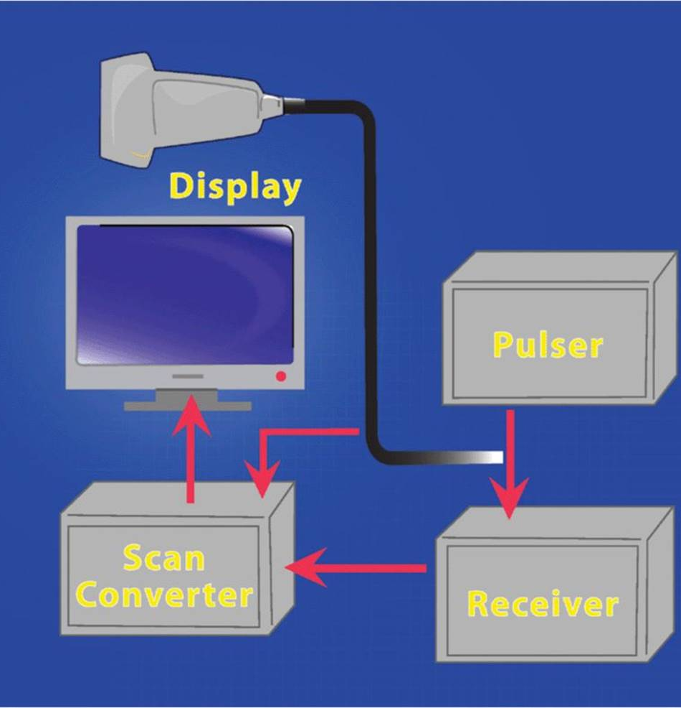
Analog Scan Converter
Advantages of the Analog Scan Converter
Excellent spatial resolution/image detail
Disadvantages
Image fade-charges on silicon wafer dissipate
Image flicker-constant switching between read and write modes
Drift-inconsistent pictures from day to day
Deterioration-tube ages and image degrades

Slide 14
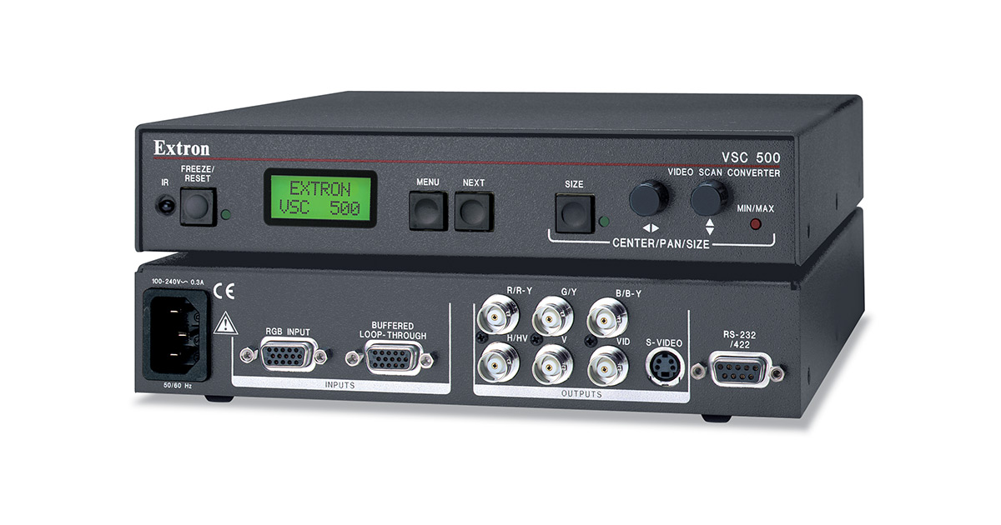
Digital Scan Converter
A computer memory and microprocessor used to digitize images.
Converts image data into numbers which are stored in memory
Numbers are processed and re-translated for display as an image.
RAM - computer memory (random access memory)

Slide 15
Digital Scan Converters - Advantages
Uniformity – consistent gray scale quality throughout the image
Stability – does not fade or drift
Durability – not affected by age or heavy use
Speed – nearly instant processing
Accuracy – error free

Slide 16

Pixel
Smallest element of a digital picture
Pixel density
the more pixels per inch, the greater detail in the image
The detail is called spatial resolution
Each pixel can only display one color at a time
The best resolution is obtained with more pixels
Spatial resolution on a digital display is determined by pixel density

Slide 17
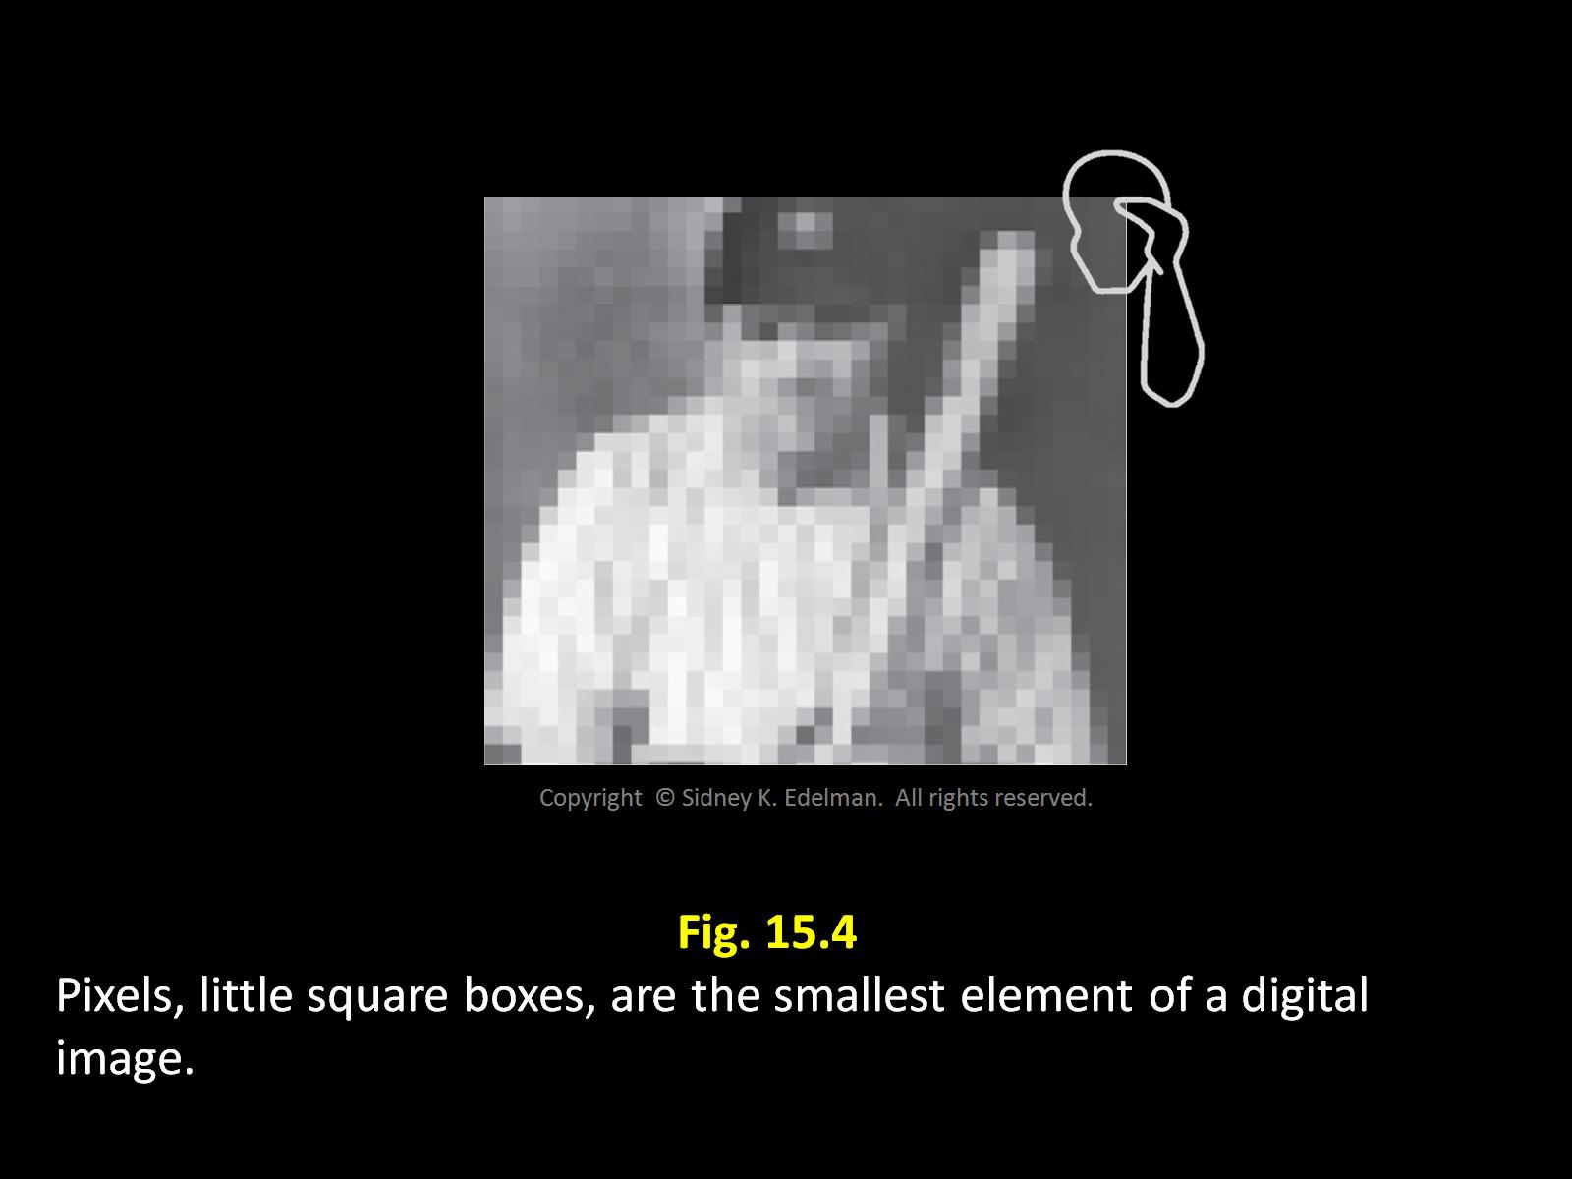

Slide 18

Bit
Derived from the term "binary digit"
Smallest amount of digital storage
Bistable - has value of 0 or 1
A group of bits is assigned to each pixel to store the gray scale color assigned to that pixel
The more bits per pixel, the more shades of gray, and the better then contrast resolution

Slide 19
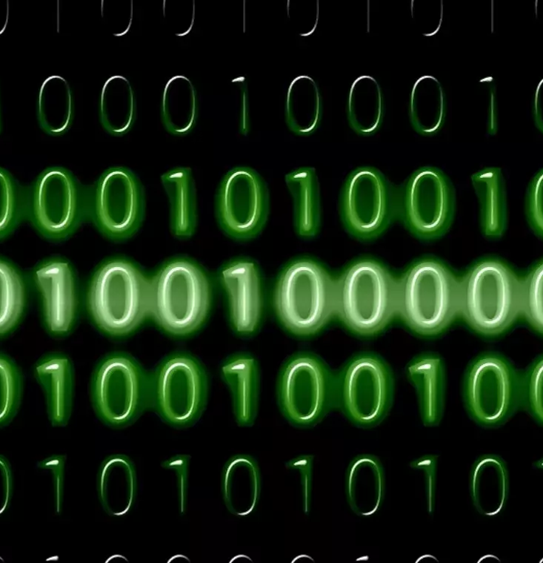
Binary Number
Computer language
A group of bits
A series of 0’s and 1’s
Example 101010101001
Byte
Group of 8 bits
Example 00001011

Slide 20

Calculating the number of Gray Shades that a collection of bits can represent
1. Find out how many bits are assigned to each pixel
2. Multiply the number 2 by itself the same number of times as there are bits
2^n
n= the number of bits

Slide 21

Example #1
Each pixel has 5 bits
2⁵ or 2x2x2x2x2=32
The largest number of shades represented by 5 bits is 32

Slide 22
Example #2
Each pixel has 8 bits
2⁸ or 2x2x2x2x2x2x2x2= 256
256 gray shades can be represented by 8 bits

Slide 23
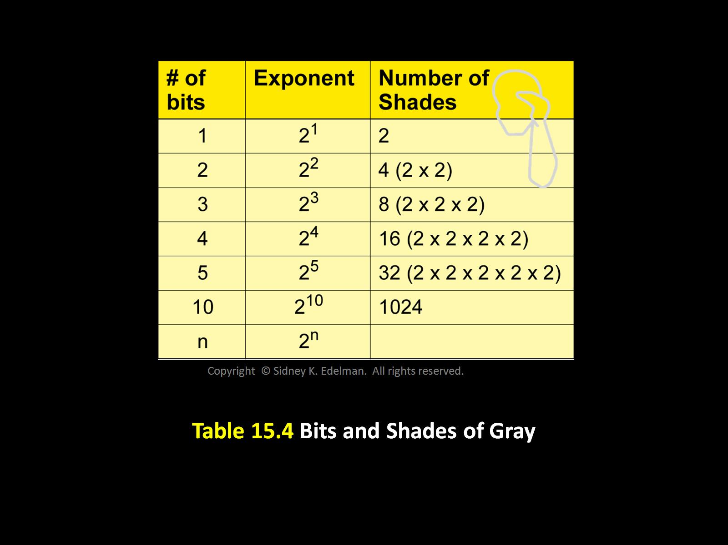
We must be able to figure out how many bits it takes to represent a certain number of gray shades.
Find the minimum number of bits that can be used by figuring out how many gray shades can be represented

Slide 24

Example #3
How many bits are needed to represent 10 shades of gray?
4 bits – why?
4 bits = 2x2x2x2 = 16 shades of gray
We cant use 3 bits because 3 bits can only represent 8 shades of gray and we need at least 10!

Slide 25

Additional Examples
How many bits are needed to represent 11 shades of gray
4 bits = 16 shades of gray
How many bits are needed to represent 15 shades of gray?
4 bits = 16 shades of gray
How many bits are needed to represent 17 shades of gray?
5 bits = 32 shades of gray

Slide 26

Analog to Digital Conversion
Analog
everyday, real world
Digital
computer world
Analog to digital conversion
Electrical signals from the transducer are analog
Digital scan converter can only process computer information
Analog signal must be converted into digital form for input into the scan converter
This is performed by the analog to digital converter

Slide 27

Digital to Analog Conversion
Information in the scan converter is digital
Televisions are analog
Signal must be reconverted to analog form before display on a TV
This is done by the digital to analog converter
Analog signal from transducer→analog to digital converter→digital scan converter→digital to analog converter→analog signal display on TV (CRT)

Slide 28
Image Processing
Pre-Processing
manipulating the data before storage in the scan converter.
Once preprocessing occurs data is altered forever.
Cannot be undone or reversed
Post-Processing
Manipulation of data after storage in the scan converter
Changes can be reversed, restores the initial values of the image data

Slide 29
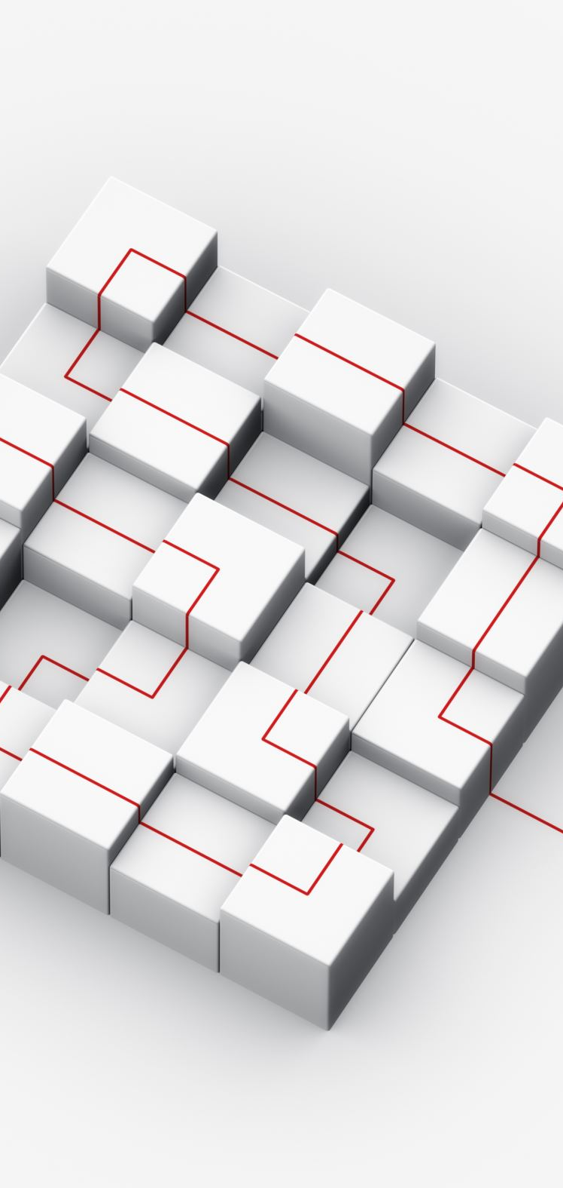
Pre-Processing
Types of pre-processing
Log Compression
Lowers the high-level echoes and boosts the low-level echoes.
Signal’s dynamic range is reduced.
TGC changes
Write magnification
Fill in interpolation
Persistence
Spatial compounding
Edge enhancement

Slide 30

Post-Processing
Post- processing
Any change after the freeze frame
Types: black white inversion, read magnification
Contrast variation
3-D Rendering

Slide 31
Pre and Post Processing
Preprocessing is any image manipulation performed before it is stored in the scan converter
It is permanent and cannot be changed
Done on a live image
Postprocessing is any manipulation of image data after storage. Occurs after A-to-D conversion. This can be reversed or restored to the original data.
Always done on a frozen image
(except some newer systems)
Notes:
Except on some newer equipment

Slide 32
Magnification
Also called “zoom” is the enlargement of a portion of an image to improve detail
It fills the screen; the area
magnified is called the
region of interest (ROI)
There are two types of magnification with one of them more superior than the other
Read magnification
Write magnification

Slide 33

Read Magnification
Read magnification
Occurs after the image data is in a scan converter.
Post-processing
Similar to zooming in on a portion of a digital photo
Can be used on a frozen image

Slide 34

Read Magnification
Occurs after image is stored; and has a 3-step process:
1. The sonographer scans an area and freezes the anatomical image.
2. Image is now converted from analog to digital and stored in the scan converter,
3. The sonographer determines the area of interest and utilizing system controls enlarges the image; the system reads and displays only the original data in the region of interest.

Slide 35
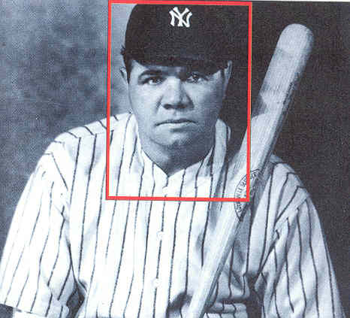
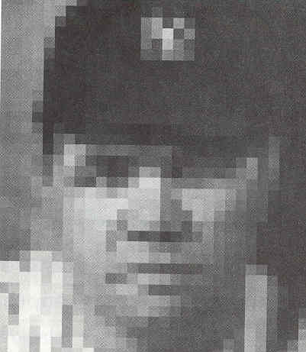
Read Magnification

Slide 36
Read Magnification
The new image has the same number of scan lines and pixels as the original image
Spatial resolution does not change because the pixel count is the same in the ROI
This process does enlarge each individual pixel.
This is performed on a frozen image – postprocessing.

Slide 37
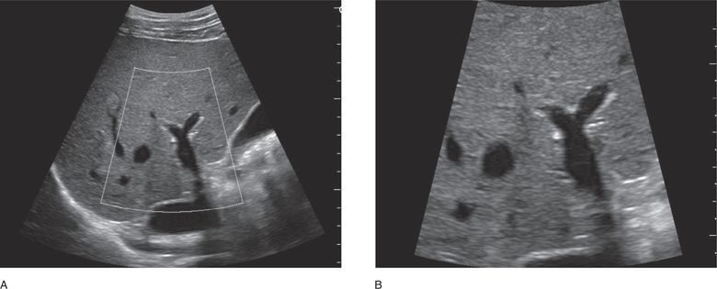
Write Magnification
Write Magnification
occurs upon acquisition of the ultrasound reflections
Preprocessing
Just like retaking a digital picture using the zoom feature
Can improve temporal resolution (only if zoomed image is shallower than original image)
When the size of an image increases: if the pixel size is unchanged, the number of pixels increases

Slide 38
Write Magnification
This is applied during data acquisition and requires a 4-step process:
1. The sonographer scans an area and freezes the anatomical image.
2. Image is now converted from analog to digital and stored in the scan converter.
3. The sonographer determines the region of interest. At that moment the system discards the old data in the scan converter
4. The system now reacquires an image only from the selected ROI and writes new data into the scan converter

Slide 39
Write Magnification
Characterized by:
discarding of the old image when the new image data is acquired
the number of scan lines or pixels in the ROI is greater than they were in the same region of the original image
Spatial resolution improves in the ROI because the number of pixels have increased in the region enlarged. Pixel size is the same.
Note the difference with write mag.: pixels were not just enlarged to make the image (read mag.)

Slide 40
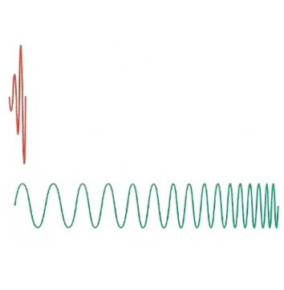
Coded Excitation
A sophisticated method of improving image quality
Coded excitation creates very long sound pulses containing a wide range of frequencies
Short pulses are used in traditional imaging (red)
Long complex pulses are used in coded excitation (green)

Slide 41

Spatial Compounding
A method of using sonographic information from several different imaging angles to produce a single image. The frames are combined to form a single real time image.
This reduces speckle and minimizes shadow artifacts
It will reduce the frame rate and temporal resolution (Can only be performed with phased array transducers)

Slide 42
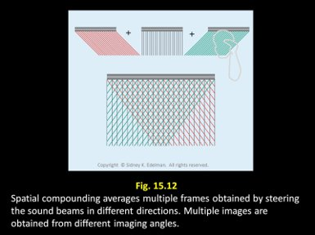

Slide 43
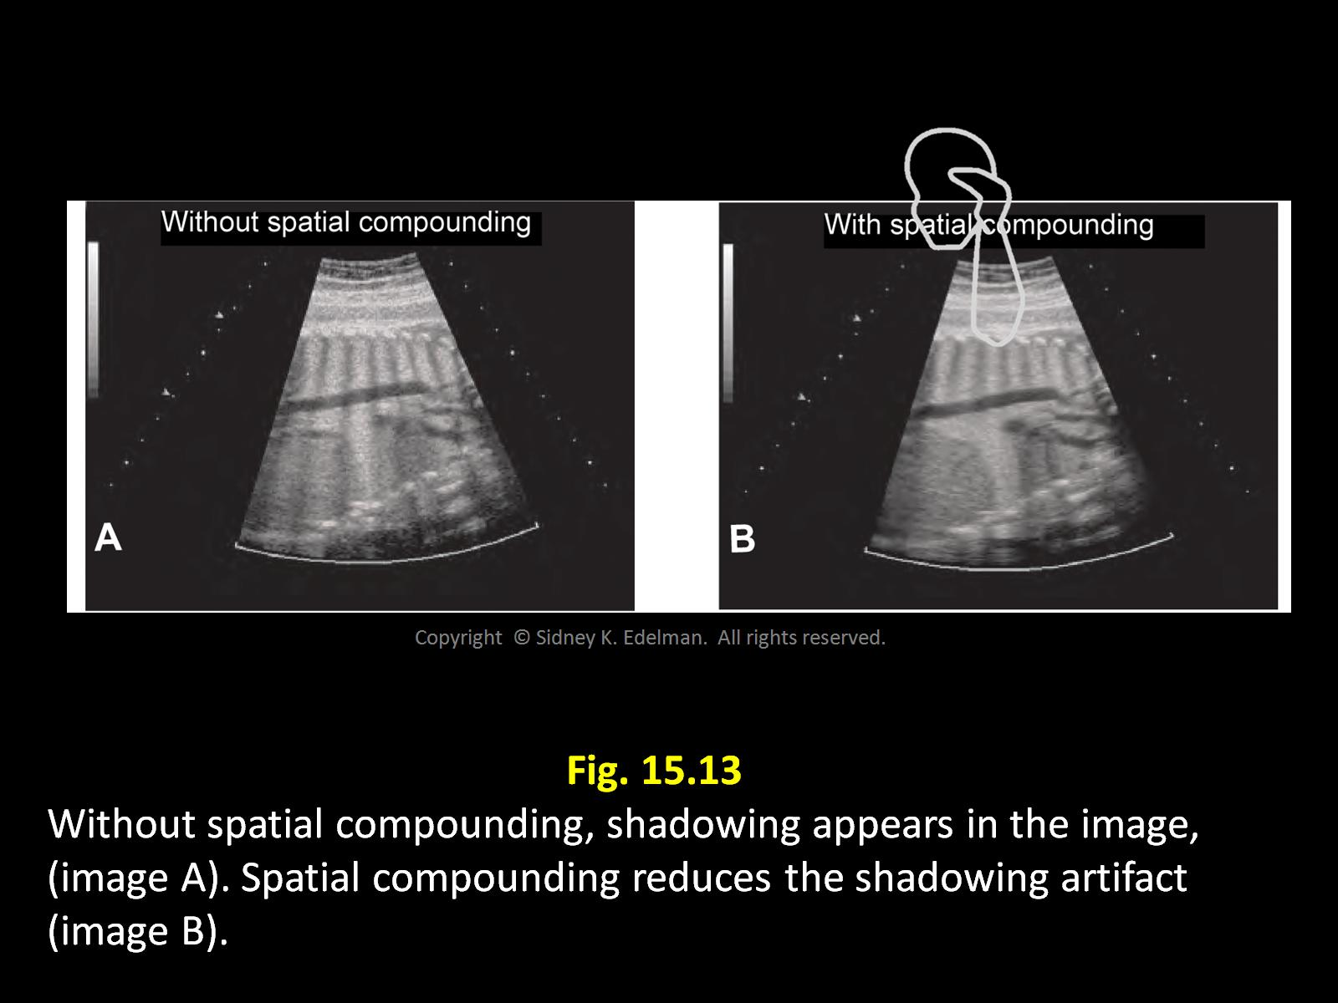

Slide 44
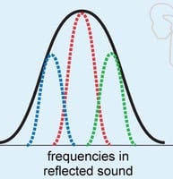
Frequency Compounding
An advanced technique that reduces speckle artifact and noise in ultrasound images.
With frequency compounding, the reflected sound (black) is divided into parts with different frequency ranges, called sub-bands (blue, red, and green)

Slide 45
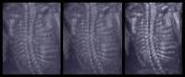
Edge Enhancement
A method that makes the pictures look sharper.
The computer identifies and emphasizes sharp edge boundaries in the image.
It creates subtle bright and dark highlights on either side of these boundaries

Slide 46
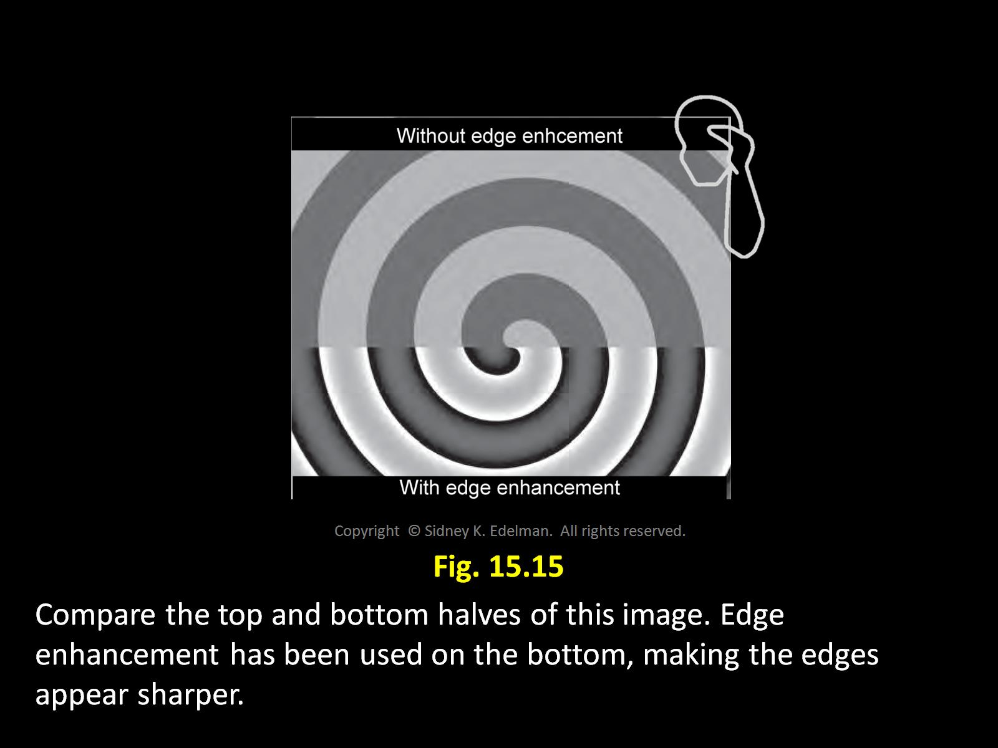

Slide 47

Temporal Compounding/ Persistence/ Frame Averaging
An imaging process technique that continues to display information from older images.
With persistence a number of prior frames are interposed onto the current frame.
A smoother image with reduced noise, higher signal to noise ration, and improved image quality is produce
This differs from spatial compounding in that all of the frames are from the same view/angle.

Slide 48
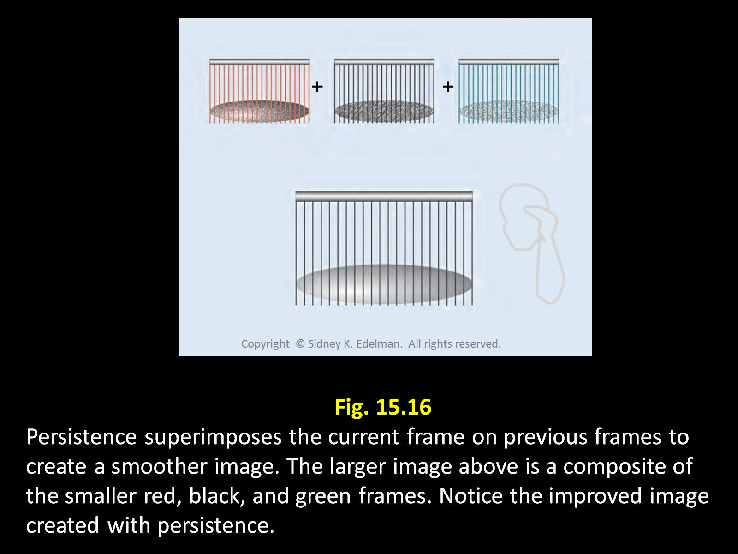

Slide 49
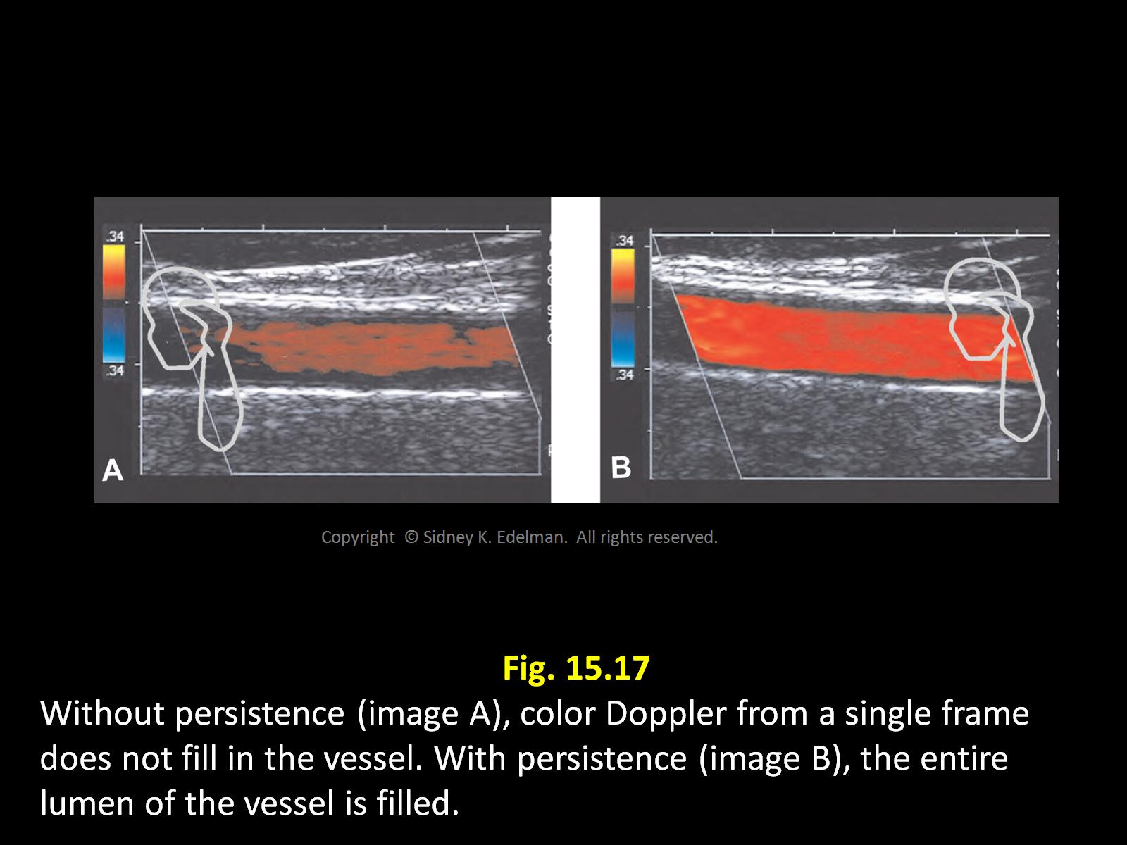

Slide 50
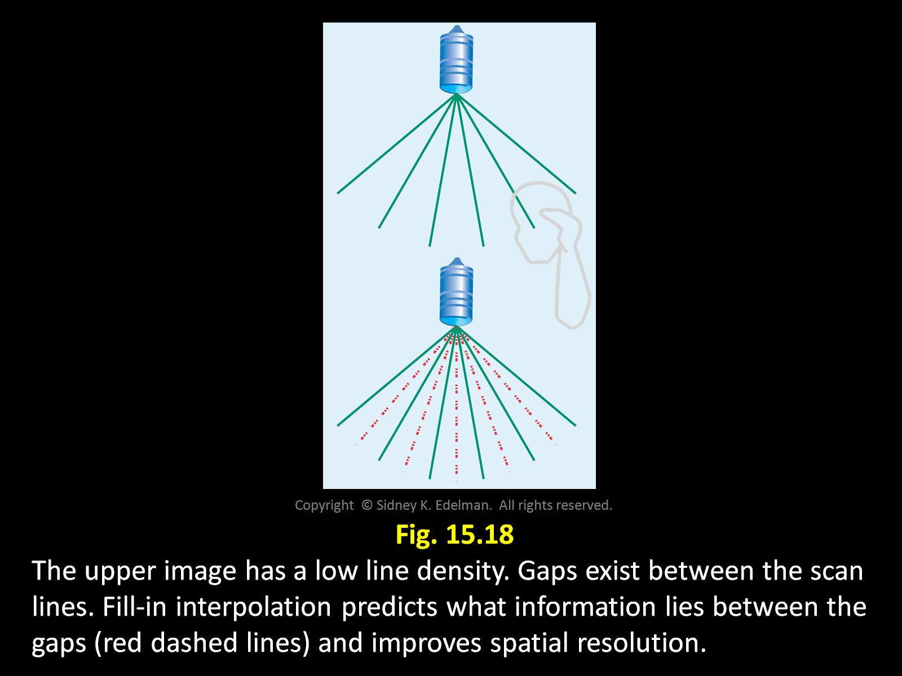
Fill-in Interpolation

Slide 51
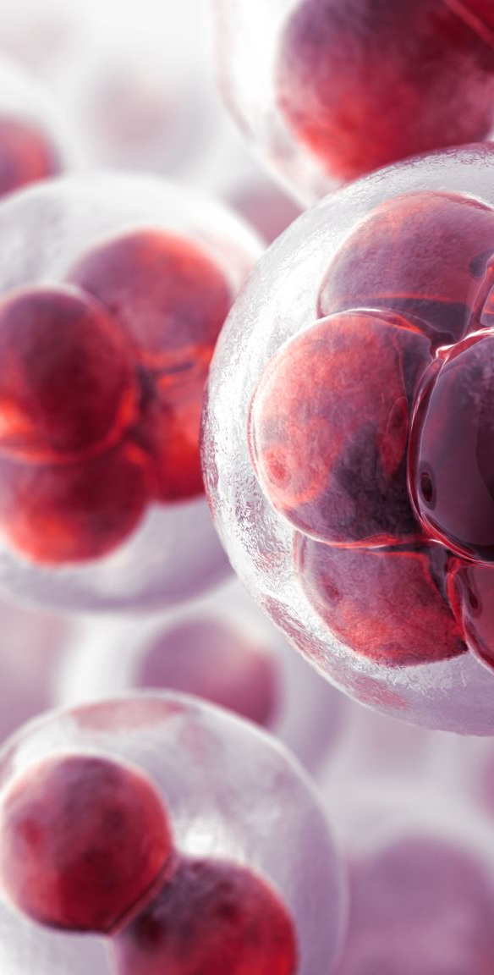
Elastography
A dynamic technique that produces images from sound reflections in a new way.
Images are related to the mechanical properties of tissue. Depending on how tissues respond to force- they will be displayed in a different way.
It is used to help distinguish between benign and malignant masses (especially in the breast)

Slide 52
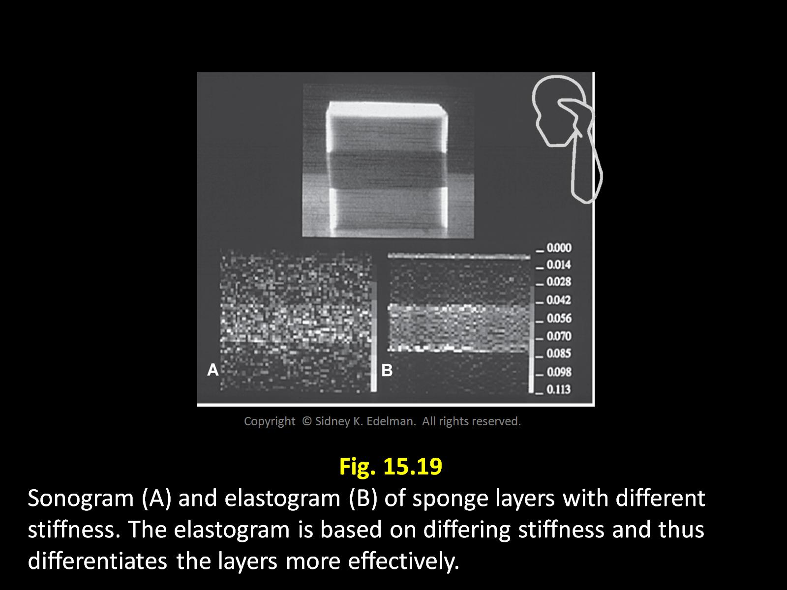

Slide 53
PACS and DICOM
PACS- Picture Archiving and Communication System- the digital ultrasound storage lab (Computer Hard drives)
Instant access
No degradation of information
Store and forward technology
DICOM- Digital Imaging and Computers in Medicine
A set of rules and protocols that allow information to be stored, and then universally connected to a PACS System

